Slide 1

How many choices do you make during a day?

Slide 2
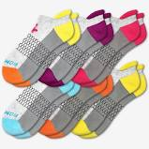


We need to understand how people make choices so that we can make better alternatives and try to predict their choices

Slide 3

Getting to know how people value the components of an alternatives help us design more desirable offering

Slide 4

What is Conjoint Analysis?
Conjoint analysis is a Marketing insight technique used to predict how product you create or re-design should perform when taken to market. How people value different features?
Conjoint analysis is used in a range of industries and for a number of strategic decisions such as: product design, product line optimization, pricing, segmentation, and market-share prediction.
Smaller size
Memory
Resolution
Selfie expert
Operating system

Slide 5
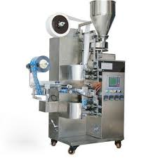
Lets take an example:
Decision Making Features
Monitor Size
Batch processing size
Noise
Speed of packaging
Quality of Packaging
Problem
There are 1000s of possible combinations of features and the marketer needs to come up with right combination at right price point
Solution
Concept test product with combination of features among potential set of customers
Choice Based Conjoint

Slide 6

Traditional surveys might not work
Which brand do you prefer? ( Apple Vs Samsung)
What interest rate will you like? ( 70% Vs 75%)
How much risk can you take? (High Vs Low)
* Such answers are often unenlightening

Slide 7
In deciding credit card how important is it to get….
Brand
Credit limit
Annual fee
Interest Rate
“I want all the features at the lowest Price”

Slide 8
Conjoint analysis mimics the real world situation and doesn’t allow anyone to say everything is important
Master Card | Visa | American Express | Citi
12 % | 9.5 % | 7.5 % | 11.5 %
No Fee | No Fee | $ 75 | $ 50
$ 5000 | $ 3000 | $ 9000 | $ 7.500
**Trade-offs are inevitable for consumers**

Slide 9
Some suggestions for deciding attributes
Too many attributes can overwhelm respondents and make it difficult to measure
CBC works best if number of attributes can be limited to 6 attributes or less
Thus focus study on most important attributes
Preliminary research can be done to understand most important attributes
Attribute levels should be short and concrete
Quantitative attributes should have 3 to 5 levels, make it same across all quantitative variables

Slide 10
Questions addressed
Which features should we include in our products/services?
How many different products/services should we offer?
How much are consumers willing to pay for each feature of our product/service? How much would they be willing to pay extra for an improvement on an existing characteristic?
How should we price our products/services?
What market share should we expect to obtain if we launch product/service X?
How do consumers differ in their preferences? Which segment(s) of consumers should we focus on serving? What product(s) would appeal to this (these) segment(s) relative to existing alternatives in the marketplace?

Slide 11

Conjoint Analysis outputs
Key Terms: Attributes, levels, profiles, Utility, partworths, utils, baseline level
Utilities
Numerical value that reflects desirability of different features
Market Simulation
Measures influence of each attribute on someone’s choice
Importance Score
Real time market scenarios to predict which products consumers are likely to choose

Slide 12
How Conjoint Analysis is conducted?

Slide 13
Case Overview
Top Market Cars pvt. Ltd. (TM) wants to understand the preferences of potential customers for environmentally friendly cars and to assess what kind of market opportunity each car configuration would present. In particular, they seek to find out what premium (if any) consumers are willing to pay for environmentally friendly cars (as opposed to gasoline-powered cars) made in the United States (vs. in other countries) and which type of car (e.g., sedan, SUV, sports) generates the greatest opportunity for the company.

Slide 14
Step 1: Choose Attributes
Find most relevant attributes
Brand origin
Body style
Engine type
Price
U( Car ) = u( Brand Origin ) + u( Body Style ) + u( Engine Type ) + u( Price )

Slide 15
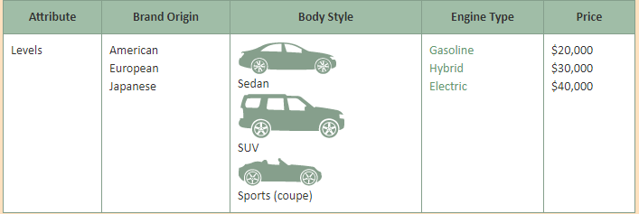
Step 2: Choose relevant levels of attributes

Slide 16
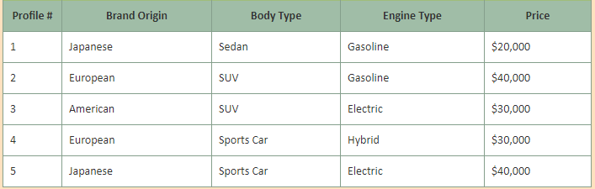

Step 3: Create product profiles

Slide 17
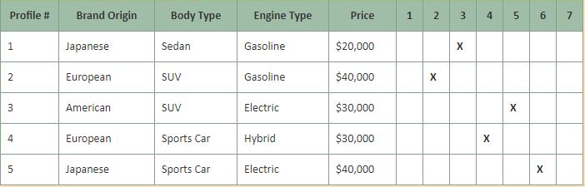
Step 4: Poll Consumers
Popular Methods: Choice Based conjoint analysis, Rating based conjoint analysis

Slide 18
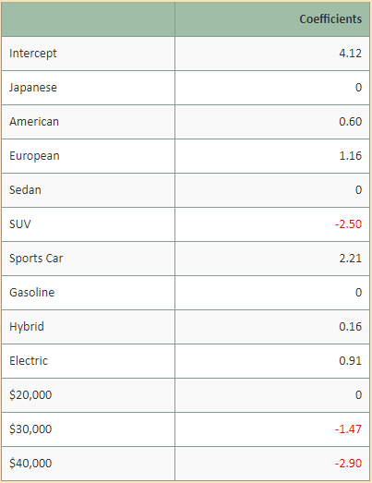
Step 5: Generate regression report
Quiz: All else being equal, which engine type does this consumer prefer?
Q: consider the following profile: European, SUV, hybrid, $30,000. According to our partworths estimates, what would be the utility of this profile to that consumer?

Slide 19
Step 6: Interpreting Partworths
The importance of each attribute to the individual is defined as the difference between the highest and the lowest partworths for that attribute
In our example, : Brand origin: 1.16-0=1.16 Body type: 2.21-(-2.50)=4.71 Engine type: 0.91-0=0.91 Price: 0-(-2.90)=2.90

Slide 20
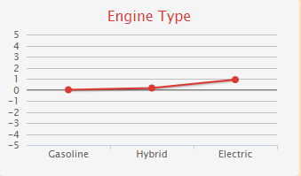
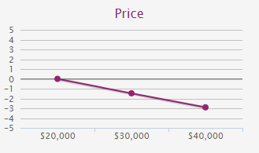
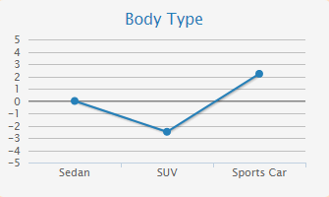
Plotting Partworth

Slide 21
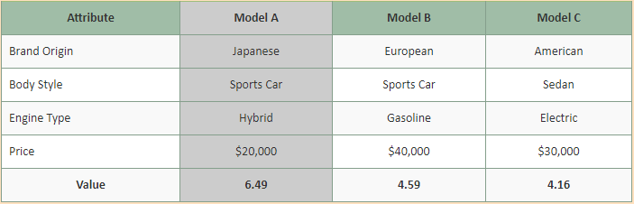
Step 7: Predict Choice

